Slide 1
Introduction to GIS
In ArcGIS Desktop 10

Slide 2
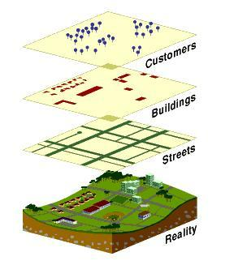
Geographic Information Systems
A computer-based system that stores geographically referenced data layers (features) and links it with non-graphic data tables (attributes)
Allows for a wide range of information processing, including manipulation, analysis, and modeling
A GIS also allows for map display and production
Data Model of Reality
Source: ESRI, Inc.

Slide 3
GIS Data

Slide 4
GIS Data Components
Features
Attributes

Slide 5
Selecting Data by Attributes
Sub-Region = South Atlantic

Slide 6
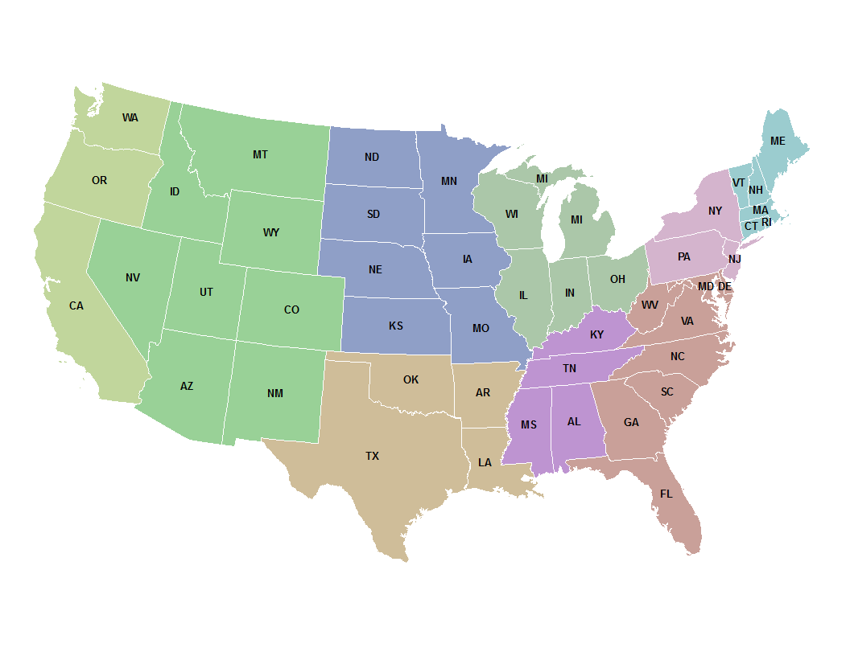
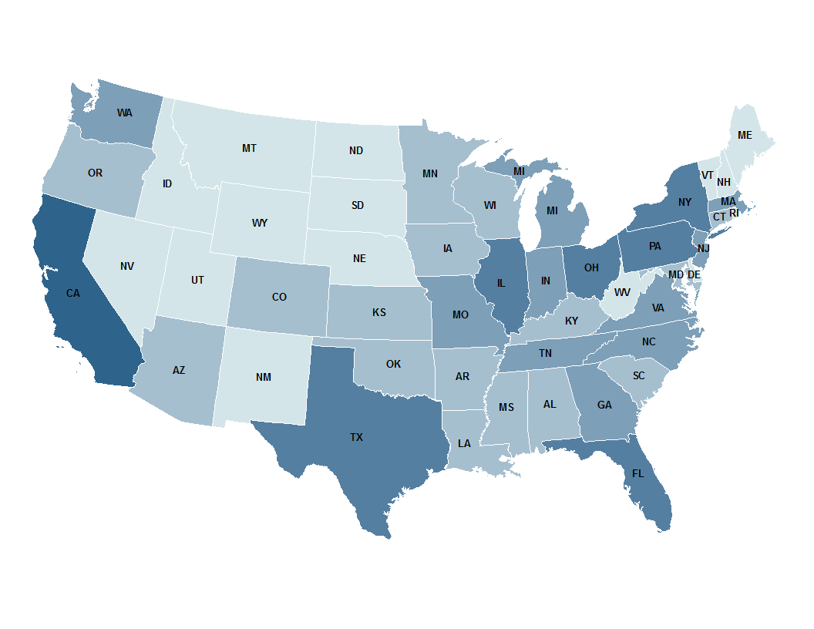
Symbolizing Data by Attributes
Display Categories (Sub-region)
Display Quantities (Population)

Slide 7
Vector Data – Points

Slide 8
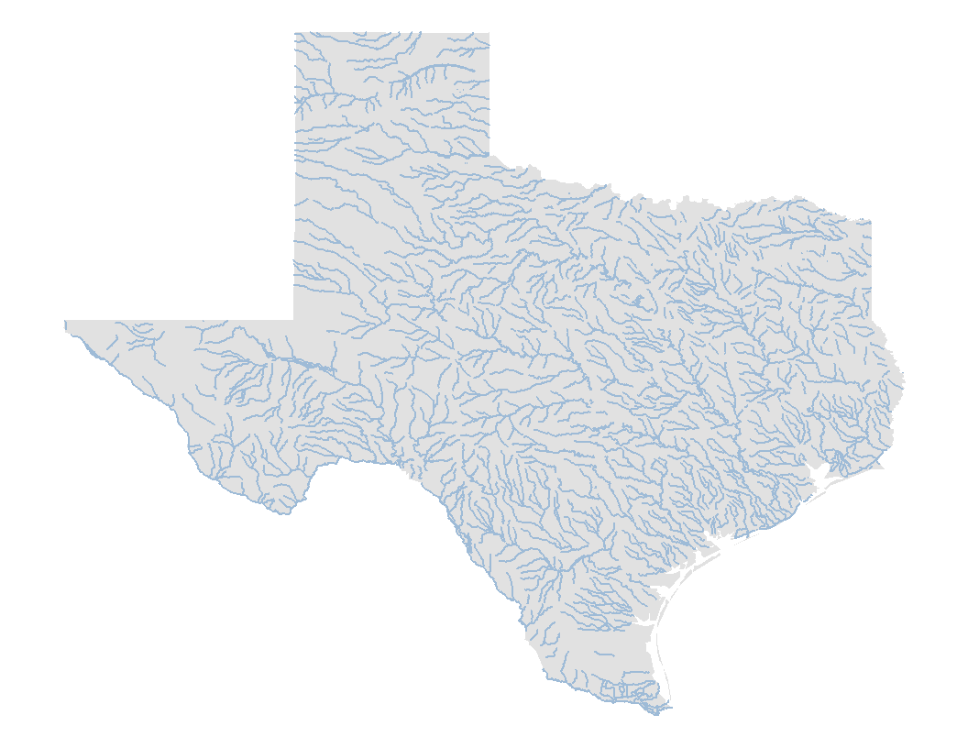
Vector Data – Lines

Slide 9
Vector Data - Polygons

Slide 10
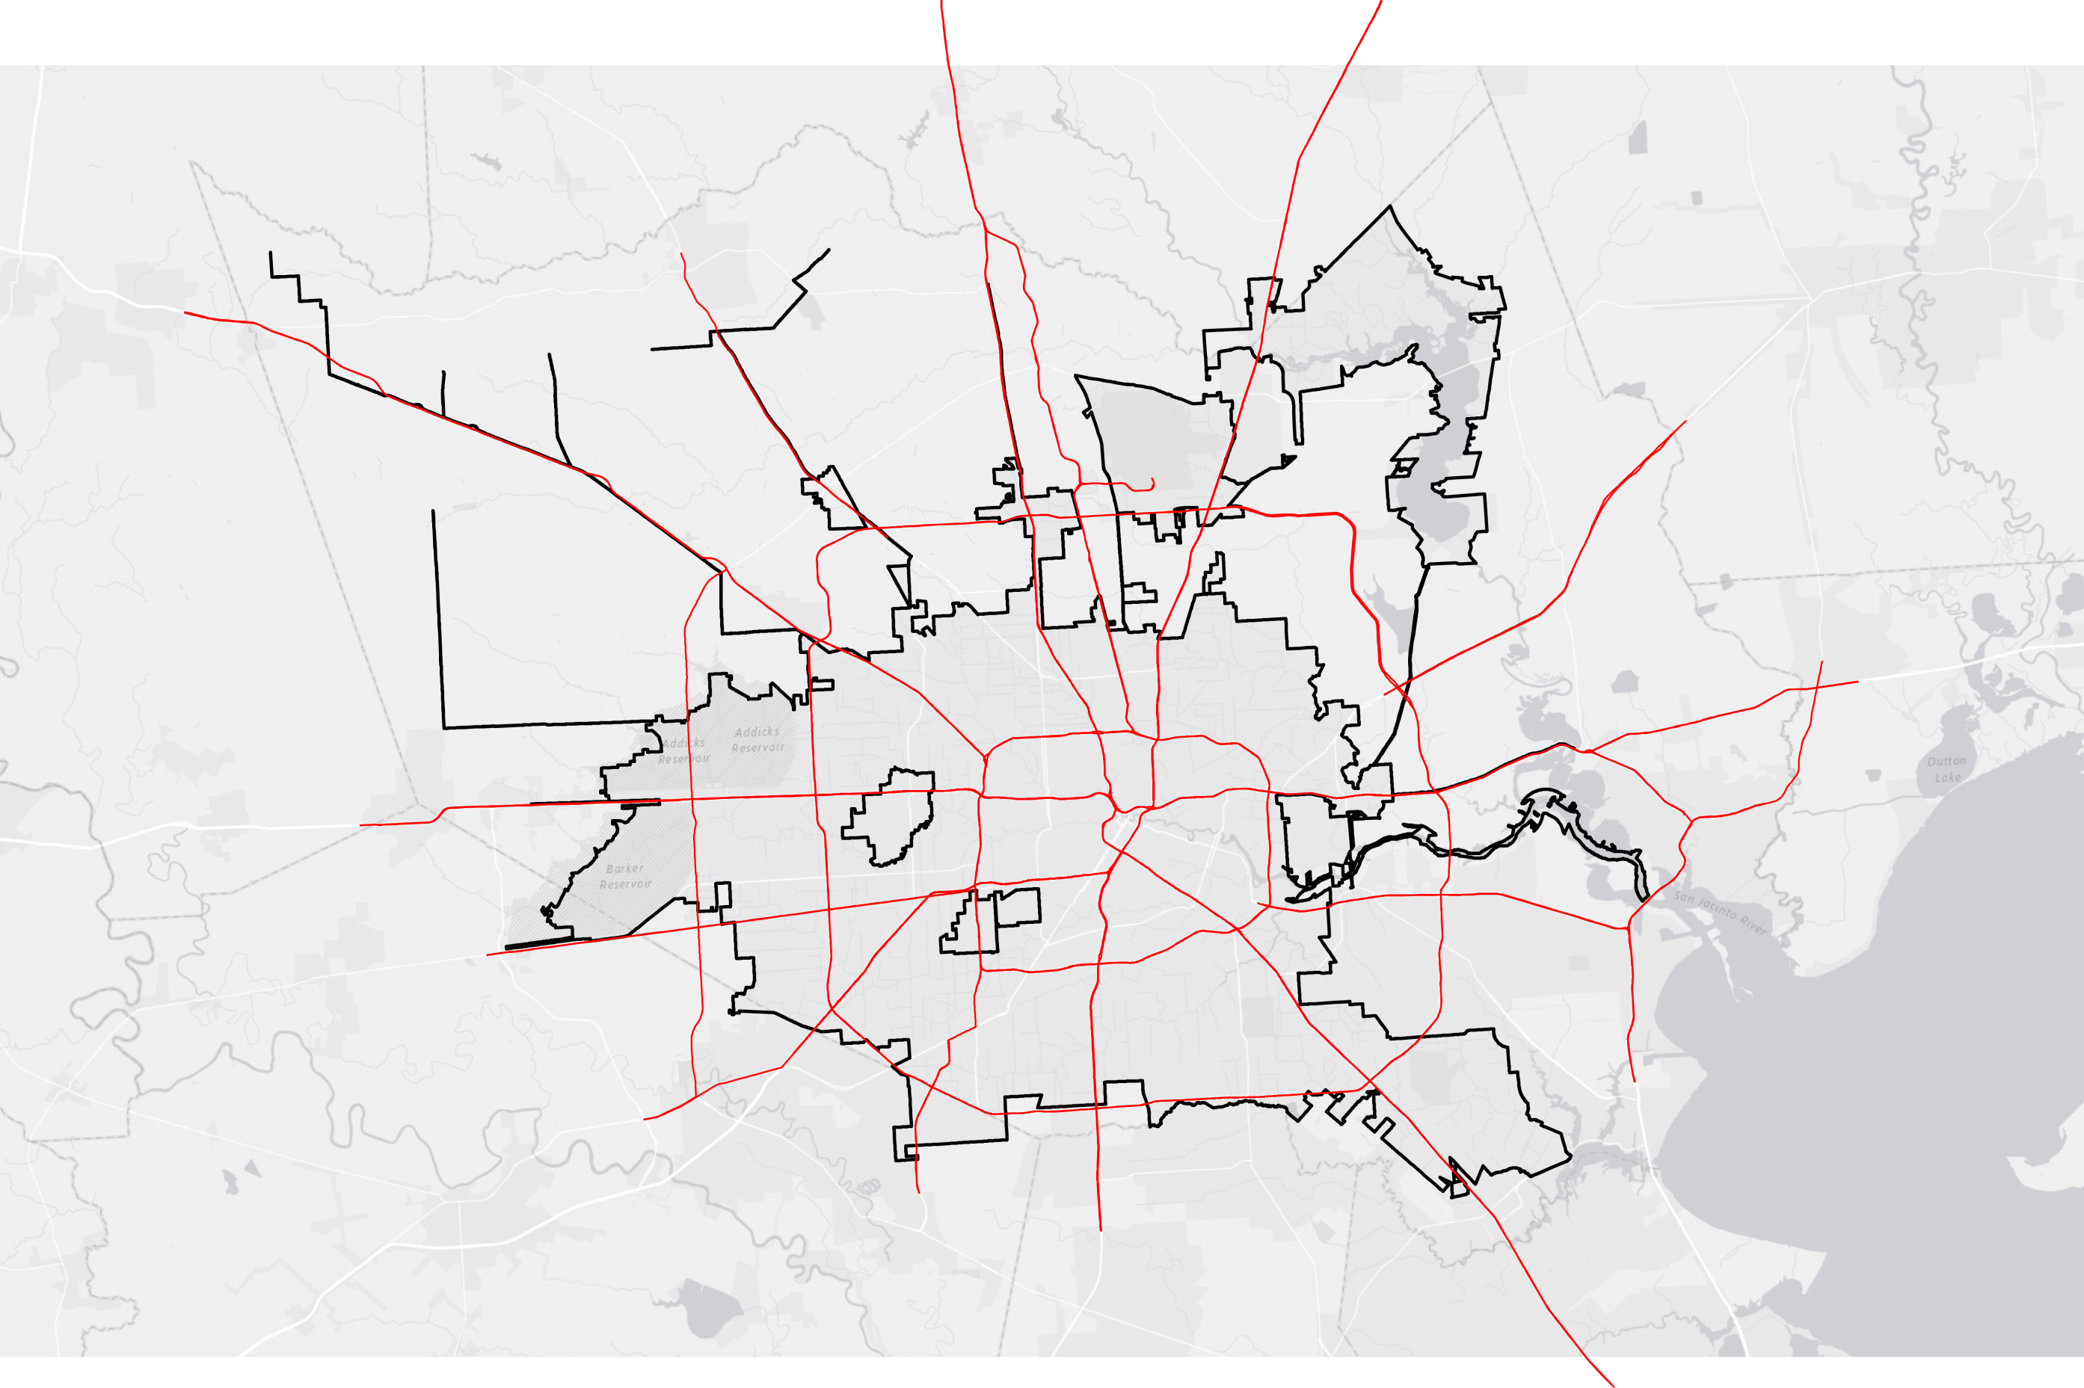
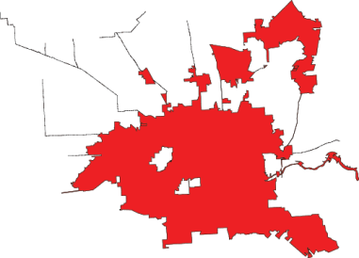
Notes:
In Houston zoom-in, keep city filled in red and make highways black.

Slide 11
Vector Data
1:1,000,000
1:100,000
1:20,000
1:2000
1:500
1:1

Slide 12
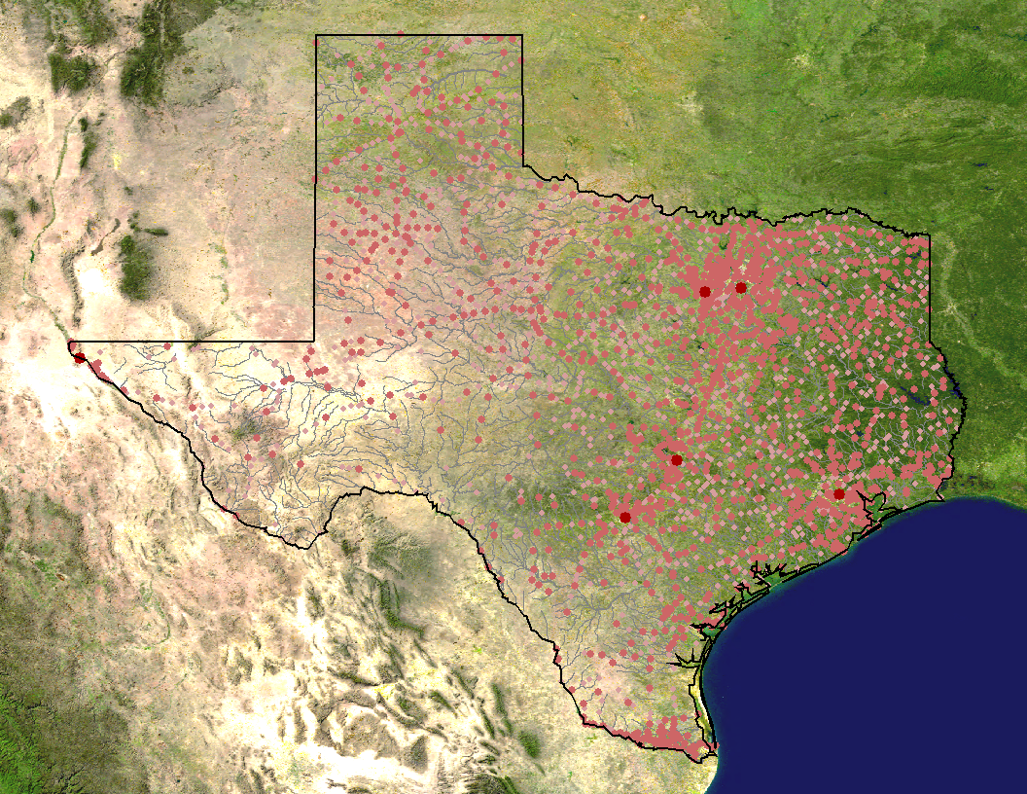
Raster Data
Vector Data
Points
Lines
Polygons
Raster Data

Slide 13
Raster Data
Orthophoto
Land Use
Concentration
Slope
Elevation
Population

Slide 14
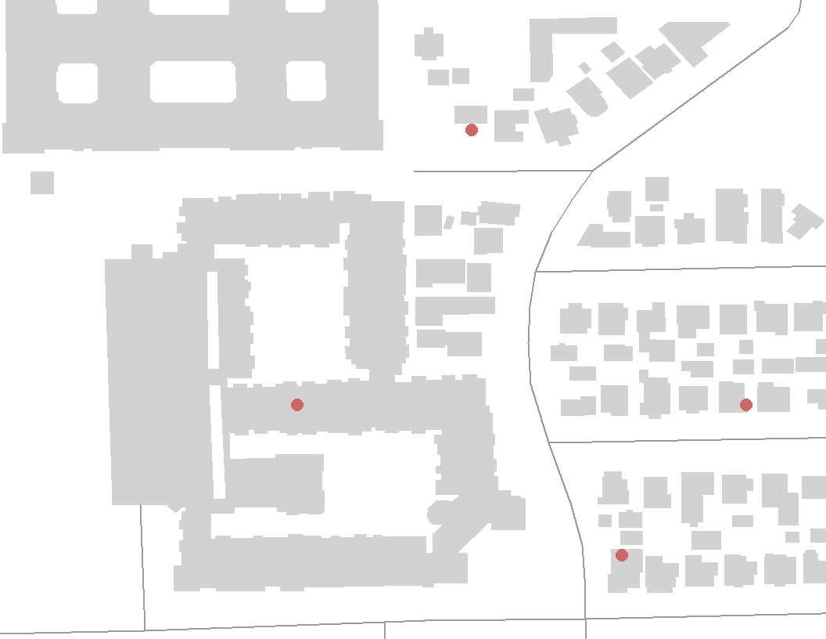
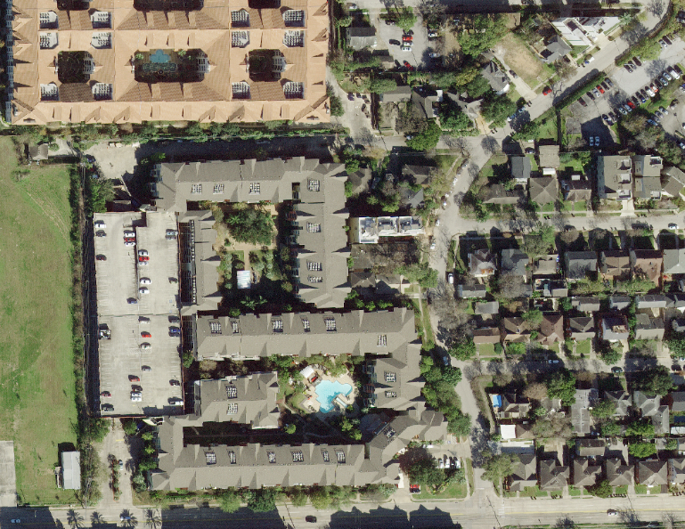
Vector Data vs. Raster Data
Vector
Uses points, lines, and polygons to represent real features on the earth’s surface, such as light poles, roads, and buildings. Ideal for discrete themes with definite boundaries.
Raster
Is composed of a continuous grid of cells that represent a value for a portion of the earth’s surface, such as elevation, and rainfall. Ideal for continuous themes of change.

Slide 15
Coordinate Systems and Projections
Projection
A method of representing the earth’s three-dimensional surface as a flat two-dimensional surface
Coordinate System
A method of representing points in a space of given dimensions by coordinates
Elevation
Longitude
Latitude

Slide 16
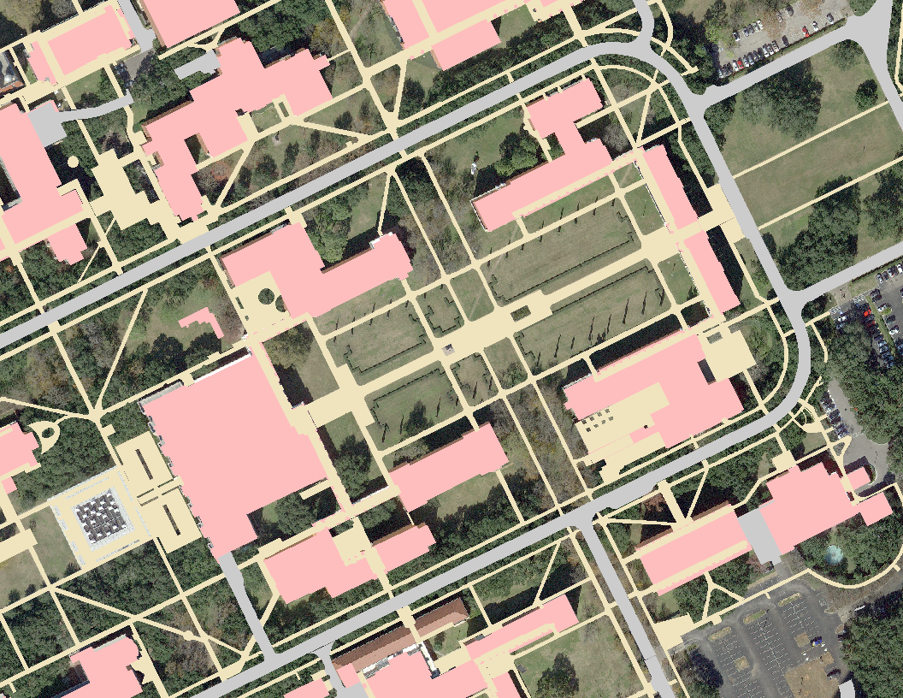
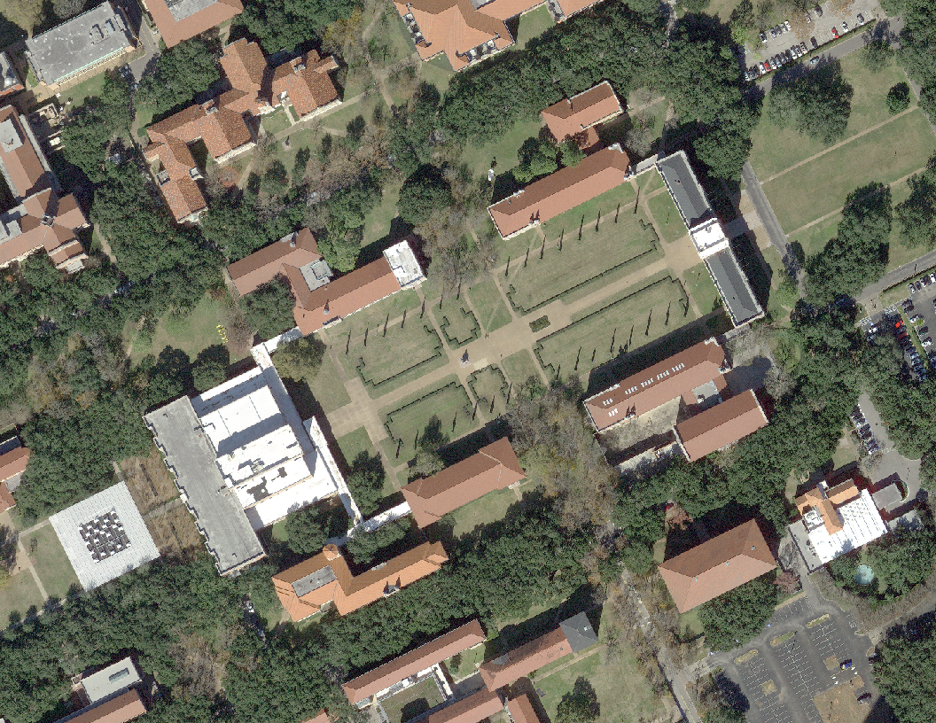
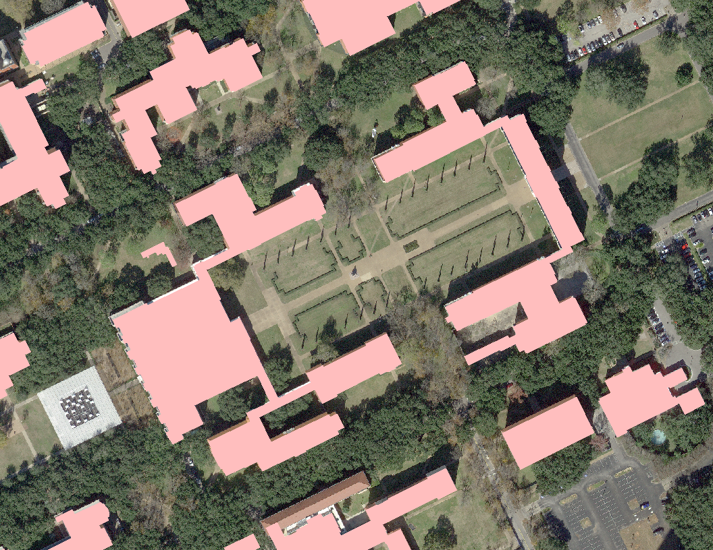
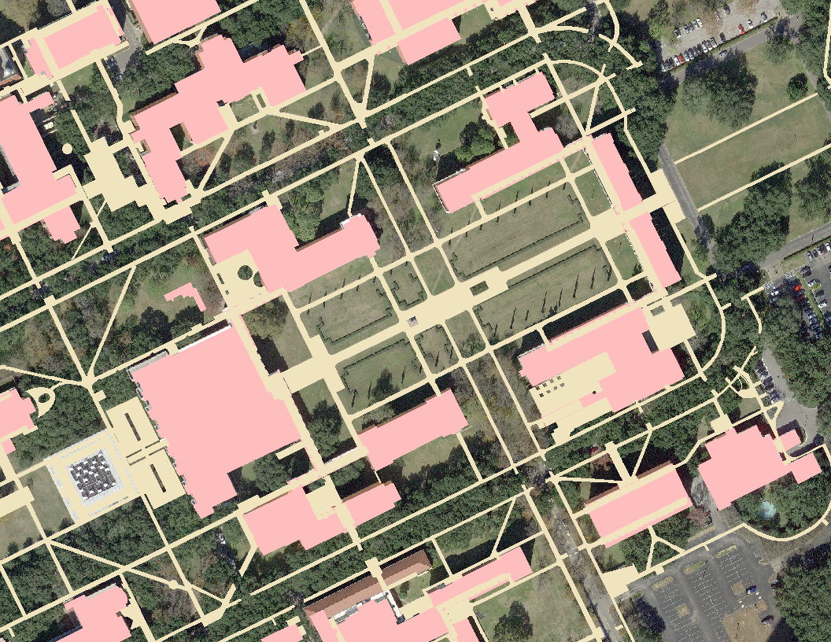
Coordinate Systems and Projections
29º 43’ 7.10 ” N
95º 23’ 55.74” W
GCS_WGS_1984
Streets
Sidewalks
Buildings
Aerial Photo

Slide 17
GIS Projects

Slide 18
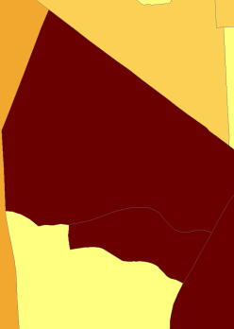
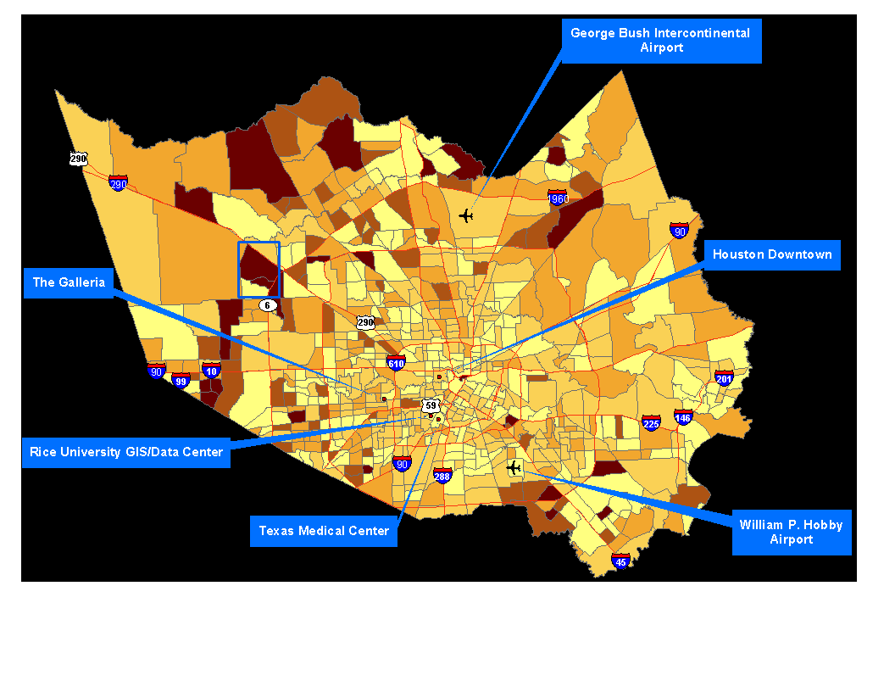
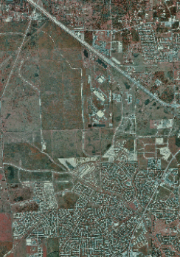
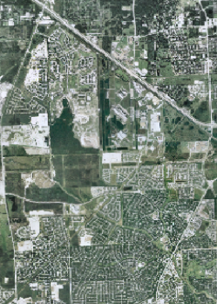
Population Change by Census Tract
1990-2000
1995
2001

Slide 19
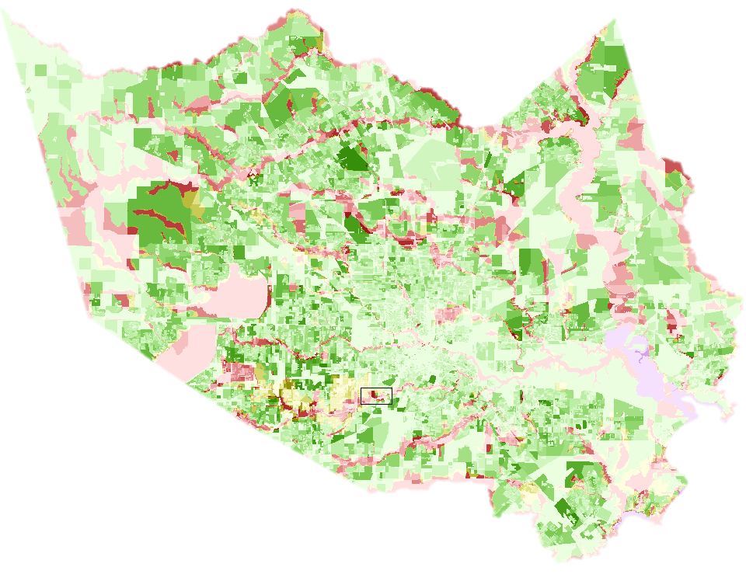
Population by Census Block in FEMA Flood Zones
AREAS OF 500-YEAR FLOOD
0 - 41
42 - 112
113 - 226
227 - 399
400 - 627
628 - 932
933 - 1346
1347 - 1983
1984 - 3010
3011 - 5930
AREAS OF 100-YEAR FLOOD
0 - 41
42 - 112
113 - 226
227 - 399
400 - 627
628 - 932
933 - 1346
1347 - 1983
1984 - 3010
3011 - 5930
AREAS OF 100-YEAR COASTAL FLOOD
OUTSIDE 100-YEAR FLOODPLAIN
0 - 41
0 - 41
42 - 112
42 - 112
113 - 226
113 - 226
227 - 399
227 - 399
400 - 627
400 - 627
628 - 932
628 - 932
933 - 1346
933 - 1346
1347 - 1983
1347 - 1983
1984 - 3010
1984 - 3010
3011 - 5930
3011 - 5930

Slide 20
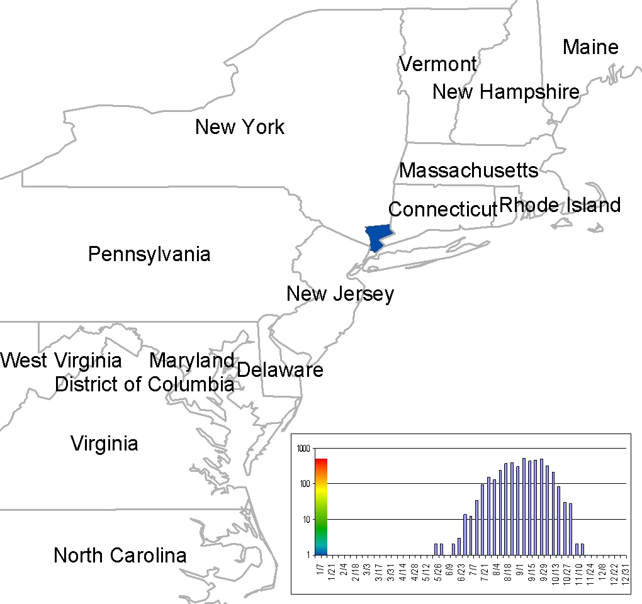
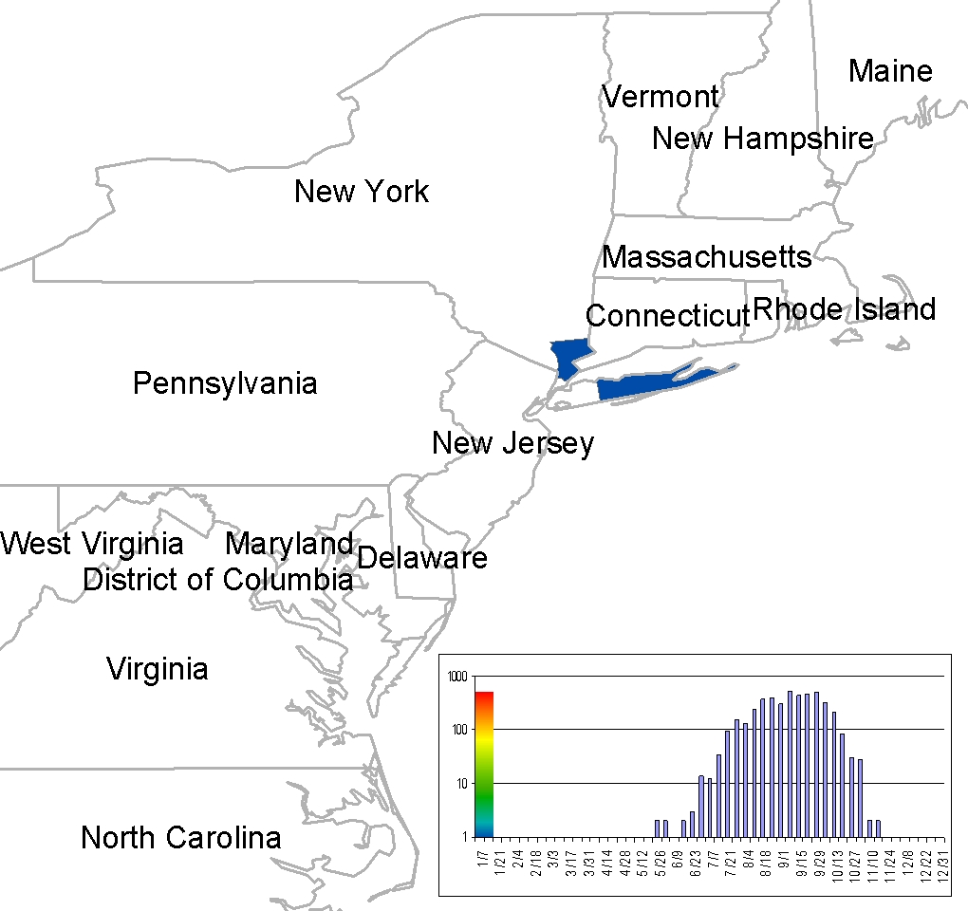
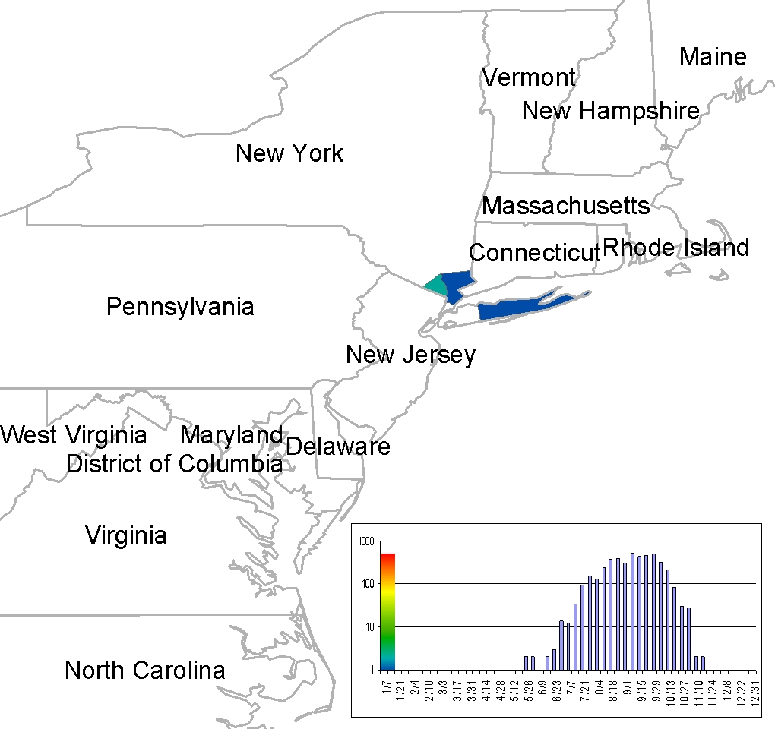
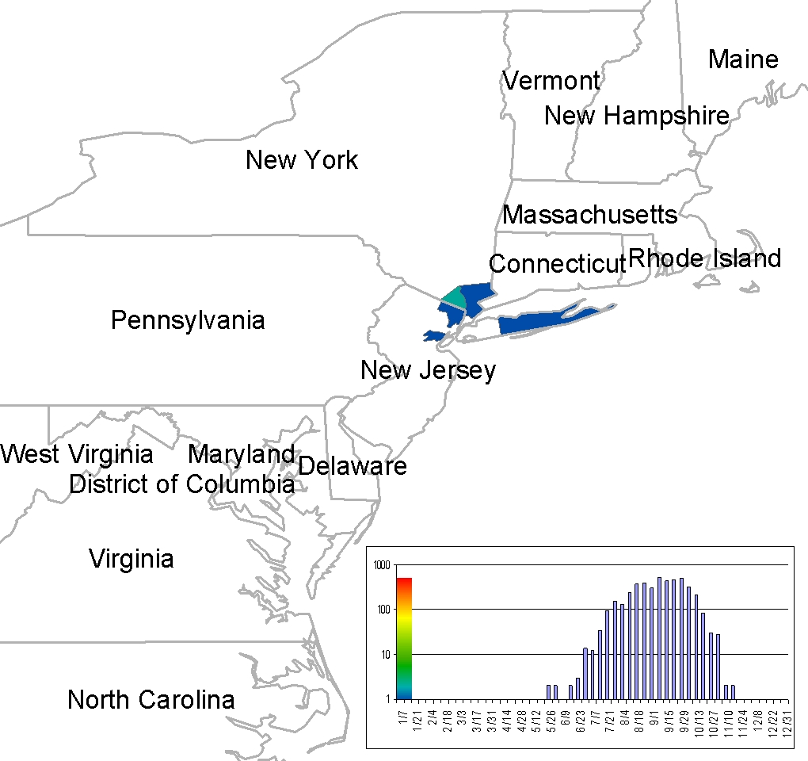
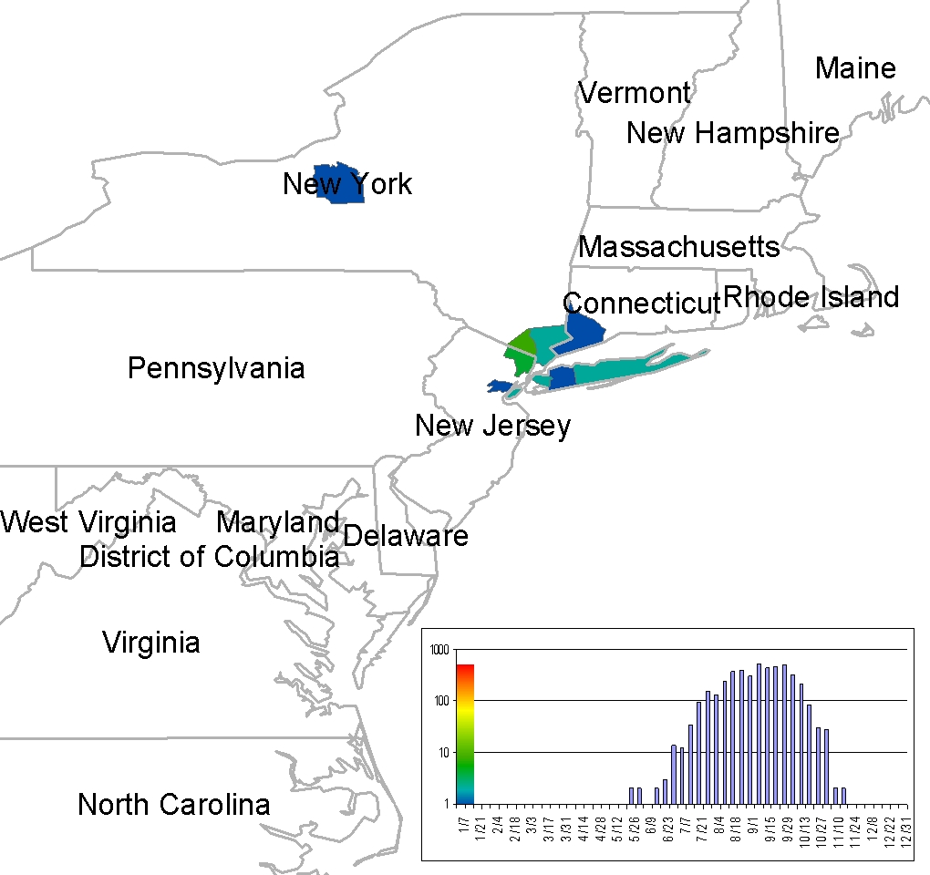
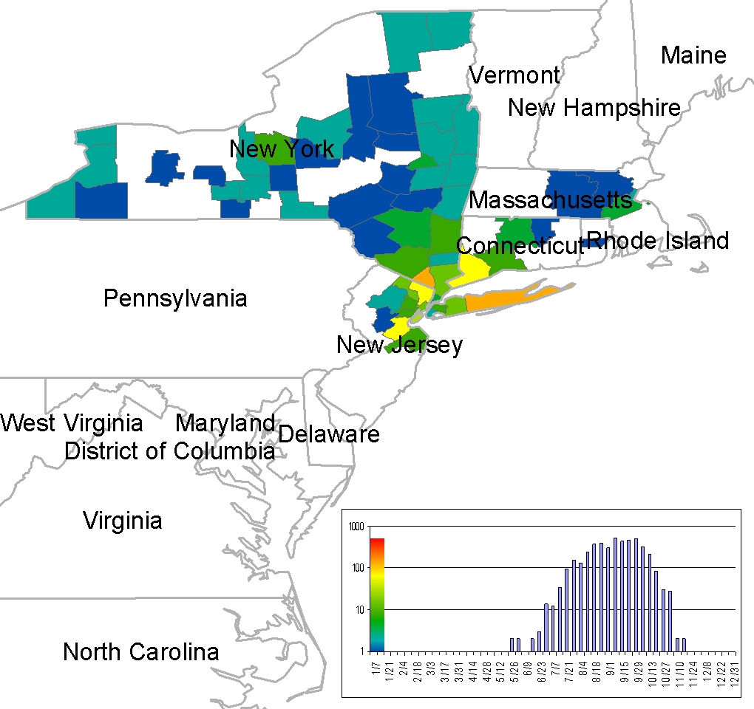
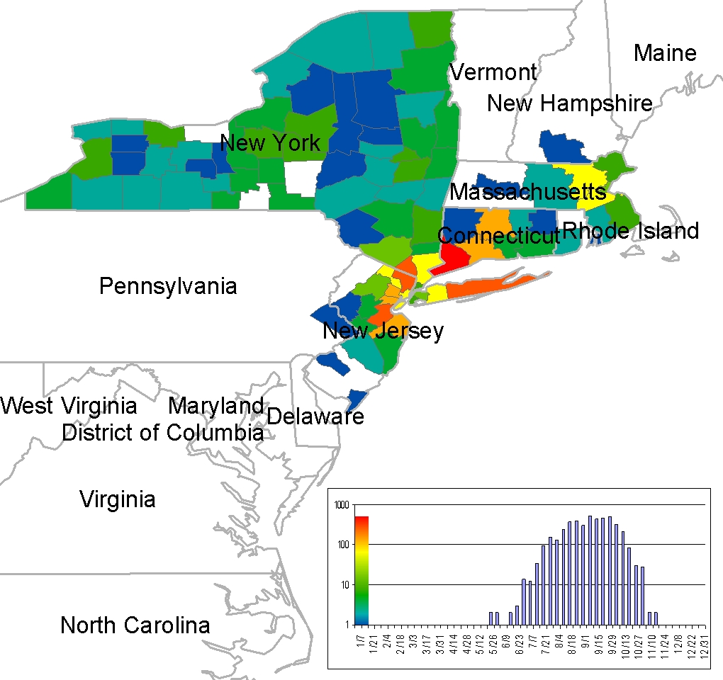
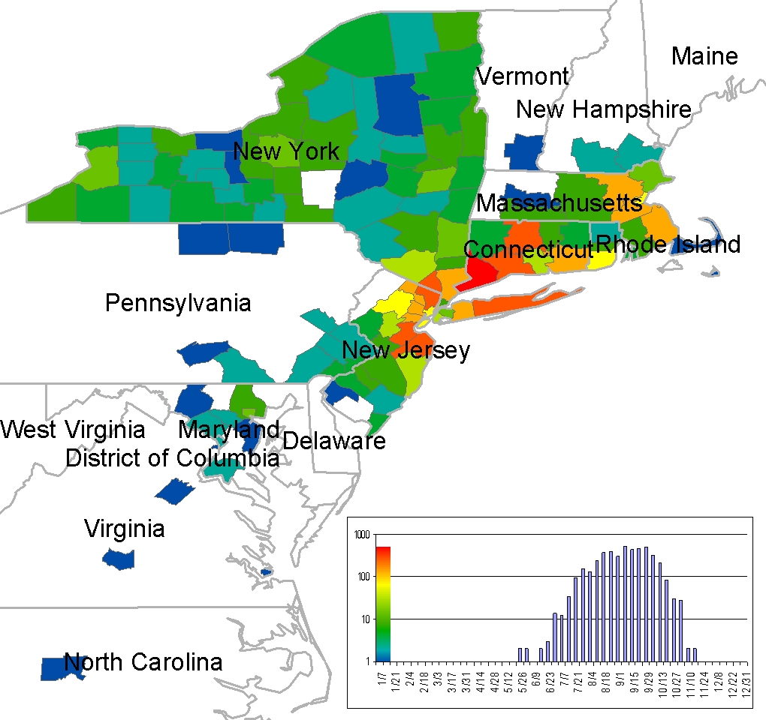
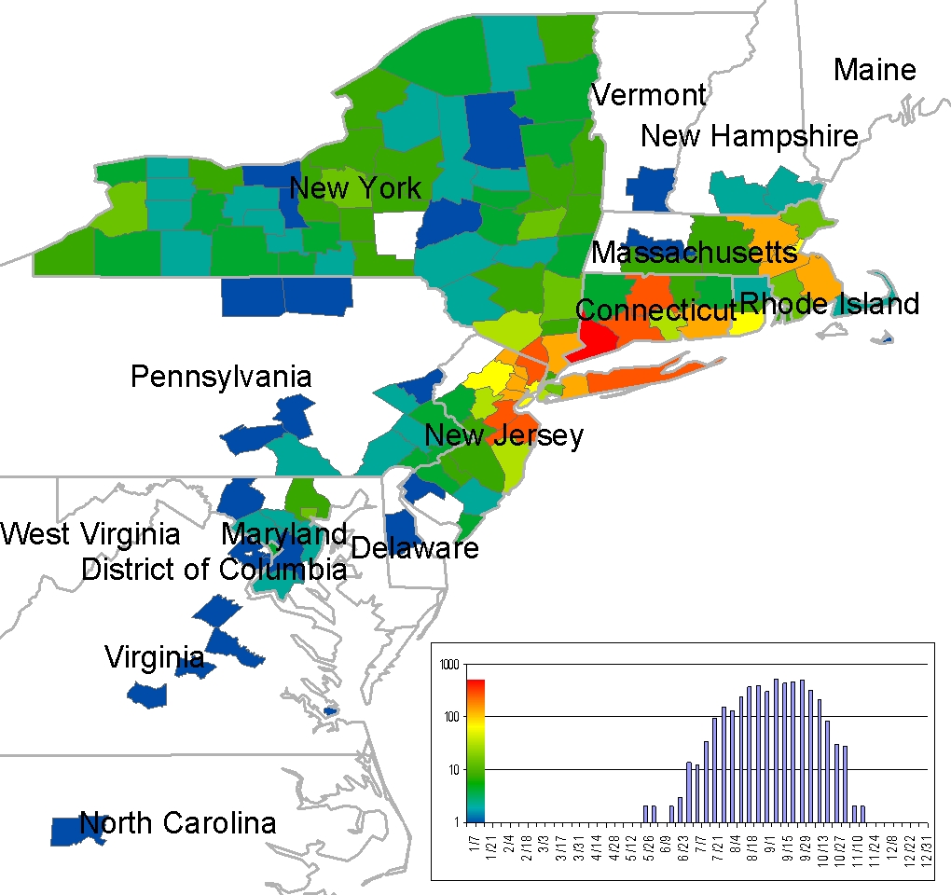
West Nile Virus Cases in Wild Birds in 2000

Slide 21
Web-Based GIS Applications
Rice University Tree Map
http://fon-gis.rice.edu/ricetrees
My City Houston
http://mycity.houstontx.gov/public
ArcGIS Online
http://www.arcgis.com
Story Maps
http://storymaps.esri.com

